Slide 1
Lecture 2
Agenda:
Install R and R studio on your system
Understand what an IDE is and what a interpreter is
Write a hello world program
Functionalize it if time permits

Slide 2
Installing R and Rstudio
Download R studio from : https://www.rstudio.com/products/rstudio/download/#download
Download R 4.2.1 from: https://cran.r-project.org/ . Download the appropriate version for your operating system (Windows/mac/linux).
Install both software in default locations

Slide 3
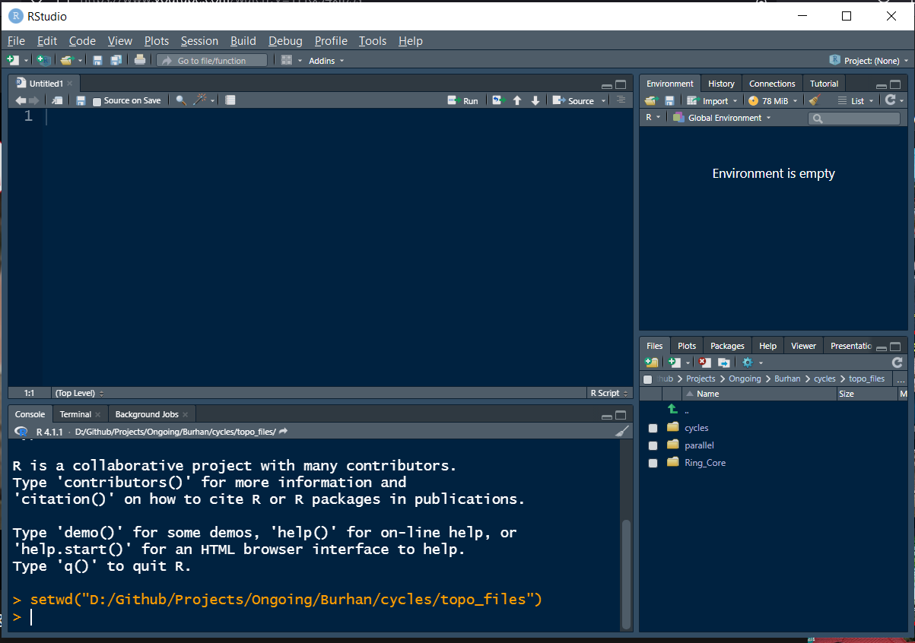
Menu bar
Text editor/
Source editor
Variable space/Environment pane
Files pane + help tab
Console
Reading material: https://teacherscollege.screenstepslive.com/a/1426910-panes-in-rstudio, https://www.dataquest.io/blog/tutorial-getting-started-with-r-and-rstudio/

Slide 4
Rstudio is an IDE
Code: A series of instructions given to the computer to perform a task
Essentials to write a code:
A text editor (notepad, wordpad etc), where the instructions are written down. Recommended text editors: Rstudio, vscode
An interpreter (R): a program that reads the code, translates them to a format that the computer can understand and have it execute the command
R studio is an Integrated development Environment (IDE).
An IDE is a software platform that hosts multiple coding requirements on a GUI based interface. An IDE must have a text editor (also called a source editor) and a console window. Additional features include code completion, debugging, syntax highlighting etc.
Reading material: https://en.wikipedia.org/wiki/Integrated_development_environment (topics section), https://www.codecademy.com/article/what-is-an-ide, https://www.freecodecamp.org/news/what-is-an-ide-in-programming-an-ide-definition-for-developers/.

Slide 5
Writing code
Method 1: Menu bar -> File -> New File -> R Script
Method 2: Keyboard shortcut: Ctrl+Shift+N
Execution of code happens in the terminal
Three ways to execute/run code:
Copy paste the code in terminal
Execute line-by-line using the shortcut Ctrl+Enter
Source the code using the source button on the top-right corner of the source editor
What are the differences in each case in the console?

Slide 6
File paths and working directory
Each source file (script) is saved in folder and has a unique path to it. (You can find out the path of a script either by running the source button, or by hovering onto the script’s tab)
Example path: D:/dummy/coding/script.R
Working directory is the directory (synonym for folder) in which R is currently in. Files in the working directory can be sourced without having to write the full path.
File in working directory: source(“script.R”)
File not in working directory: source(“D:/dummy/coding/script.R”)
Useful commands: getwd, setwd (read about them in the help tab bottom right)
Easy way to set working directory: Menu bar -> Session -> Set Working Directory -> Source File Location
Related error message: cannot open file ‘script.R': No such file or directory

Slide 7
Variable
Variables are placeholders for data
A = 3
B = “text here”
Names of variables should not start with numbers
https://www.w3schools.com/r/r_variables.asp
Related errors: object not found

Slide 8
Hello world program
Print hello world : print(“Hello world”)
Print your name: print(“Kishore”)
Create a variable that takes a name and print that variable
X = “Kishore”
print(X)

